Slide 1
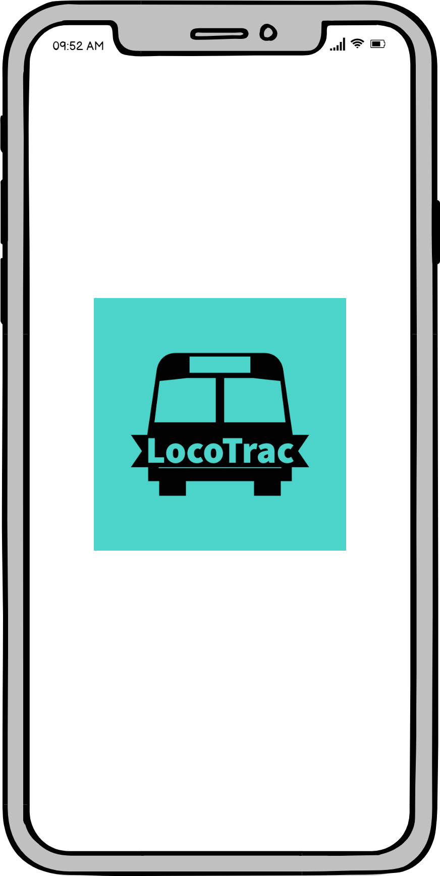
LocoTrac
Pitch Deck

Slide 2
Outline
The Problem
Solution Proposal
Screenshots
Next Steps

Slide 3
The Problem
Though buses in fixed routes have scheduled timings, most of the time these schedules are not followed due to traffic and various other factors. This may create a lot of inconvenience for the passengers waiting for the bus. Also, the schedules are available at the station only, not available digitally, so people aren’t able to get access to these schedules. Thus in such a situation, it would be helpful if the passengers could have a live update regarding the status of each bus.
Design a system to implement this requirement.

Slide 4
What customers do today
No proper system to track local bus online
People ask nearby shops around the bus station to know the schedule

Slide 5
Solution Proposal
Real Time bus tracking system using gps data from bus
Rush of bus calculation using data from ticketing machine of each bus
Schedule data made available public
Nearest bus stations identification using geo location

Slide 7
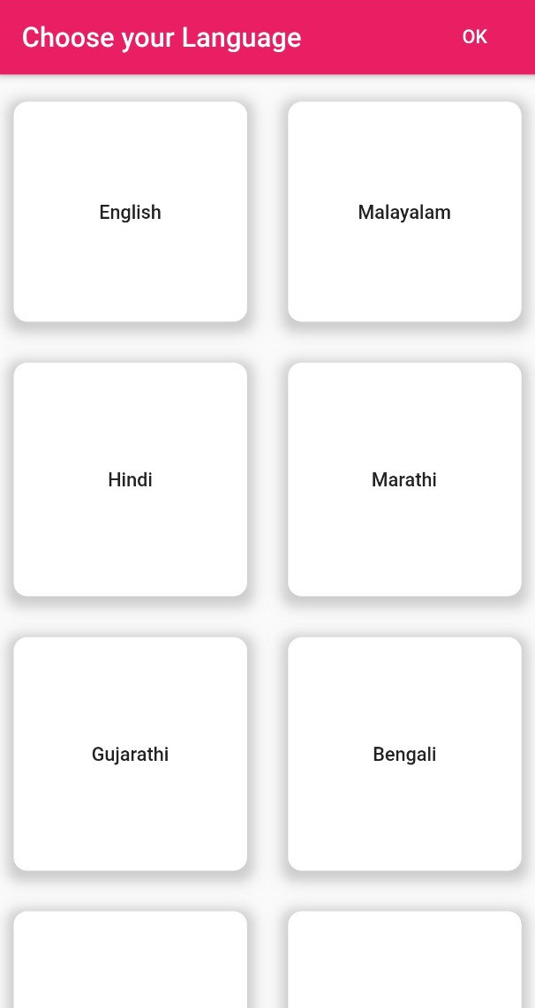
The user can select in which language he wishes to use the app.

Slide 8
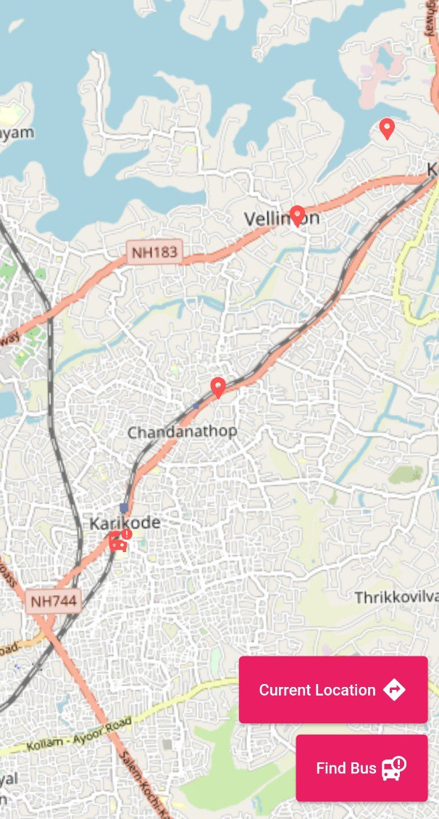
Current location of the user will be shown using a marker
All the bus stops nearby the user will be shown on the map
Top button on the bottom right corner will recentre the map according to user’s current location
Lower right corner button will navigate screen to find bus

Slide 9
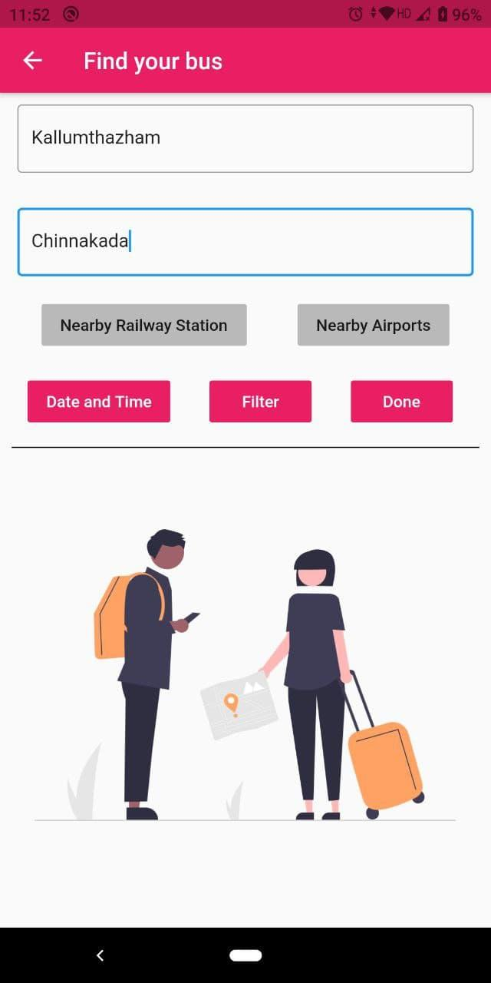
The user can enter the starting stop and ending stop
The user can click on the nearby railway station or nearby airports button to automatically assign the destination
Date and time button will navigate to date and time screen
Filter button will navigate to the filter screen
Done button will navigate to the bus list screen.

Slide 10
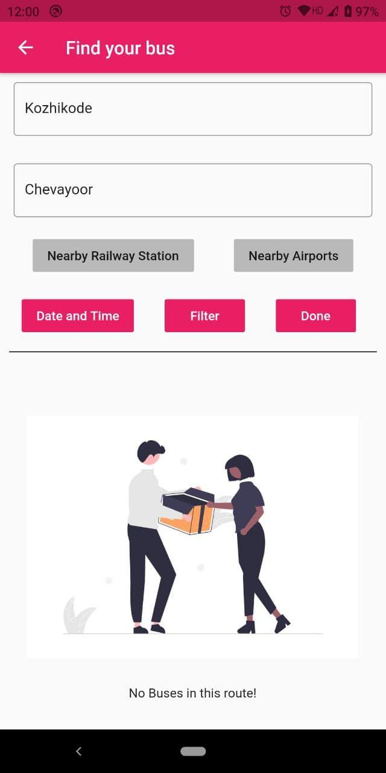
This page will be shown if there are no buses from the starting stop to the destination stop.

Slide 11
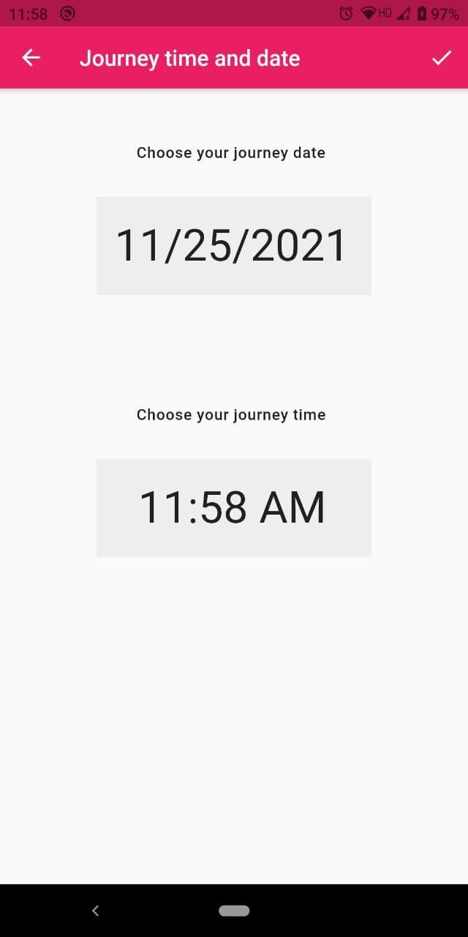
Using this date time screen the user can set the date and time of the journey.

Slide 12
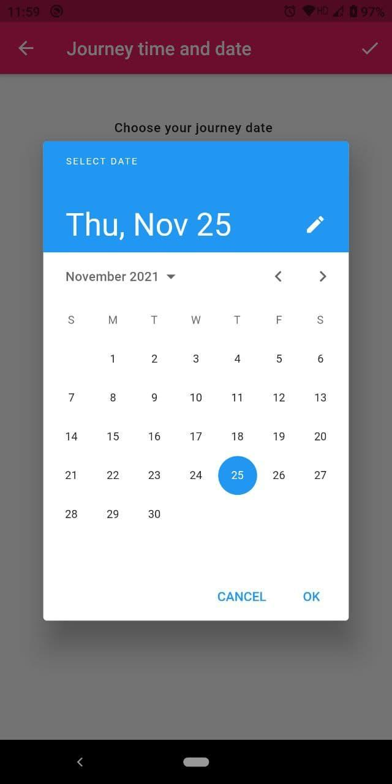

Slide 13
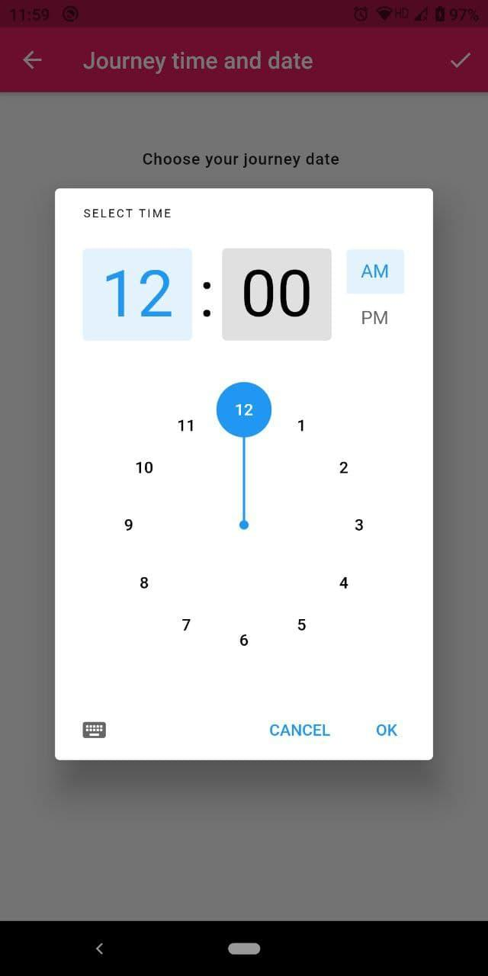

Slide 14
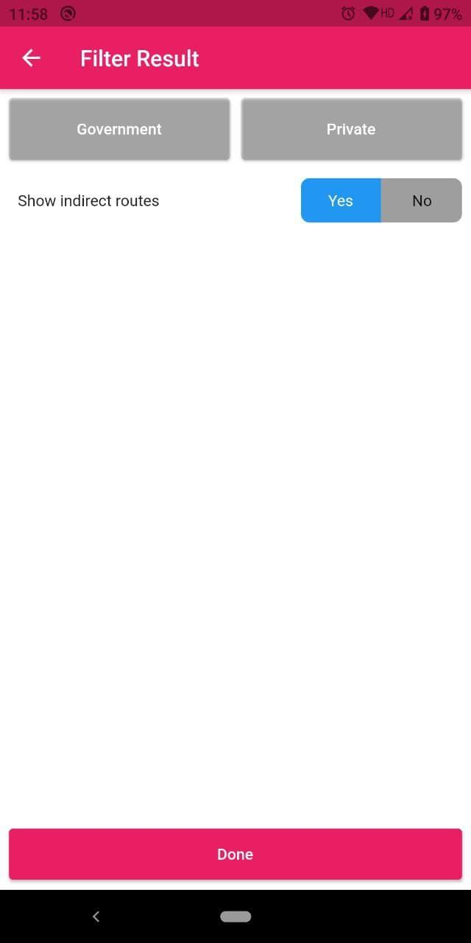
The user can filter if the buses should be Government or Private.
The user can select if indirect routes connecting two stops should be shown.

Slide 15
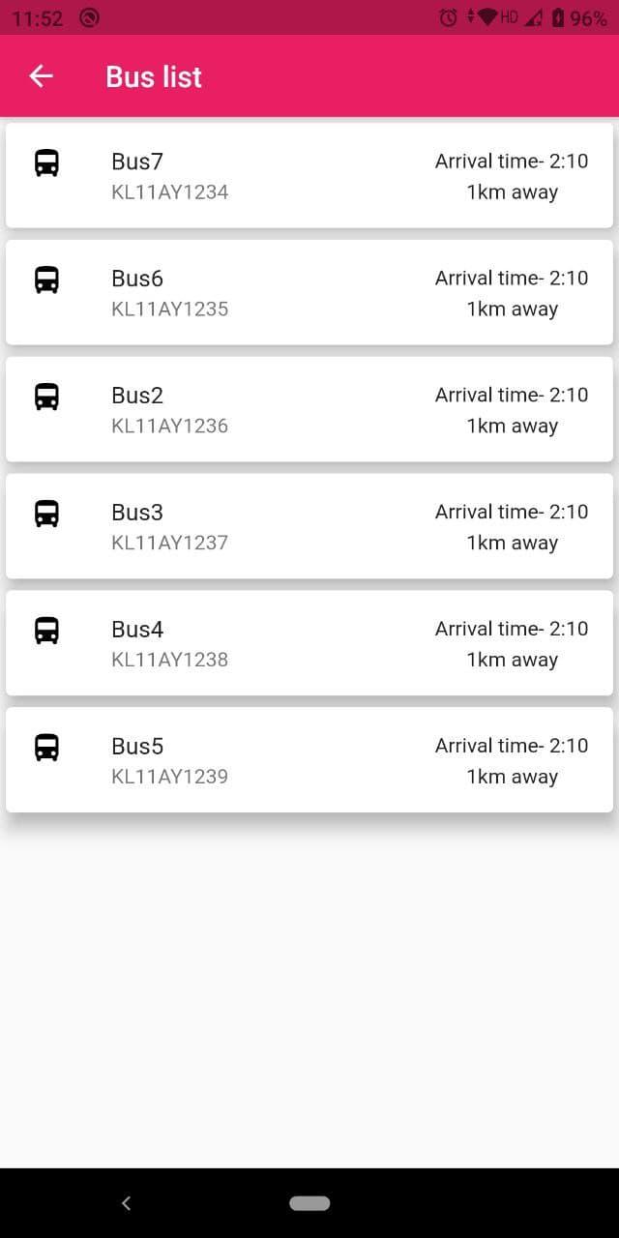
This page will list the buses connecting the starting stop and destination stop.
The estimated arrival time will be shown.
How far the bus is away from the station will also be shown.
The user can select any of the buses he/she wants
.
Upon clicking on any bus user will be directed to the bus details page.

Slide 16
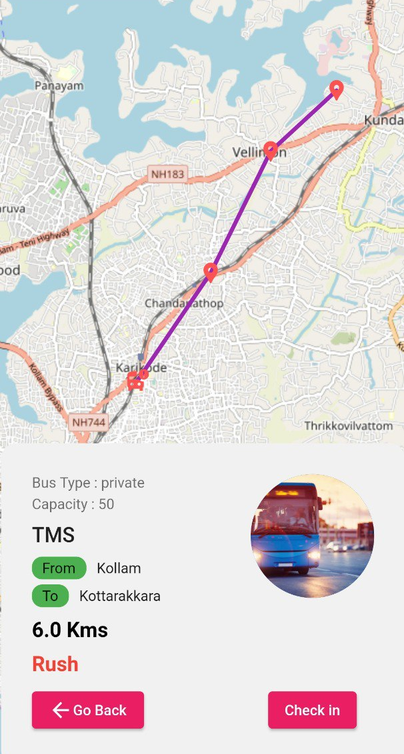
The map will show the route of the bus.
The current location of the bus will also be shown in the map.
Clicking on the Rush button will show if there is rush in the bus.
Check in is clicked if the user decides to get in the bus.
Information like Bus type ,capacity ,from and to are shown.
Facility to get the driver number is also given.

Slide 17
Admin Portal
Complete access to the admin
Share common database with mobile application

Slide 18
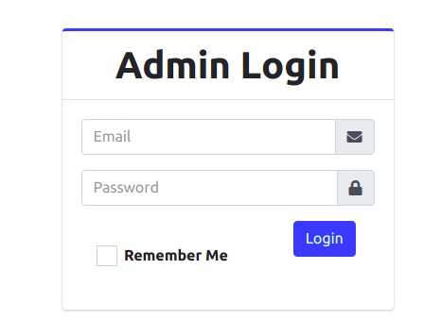
Login
Unique login credentials
Add, edit and delete data
Info about app available

Slide 19
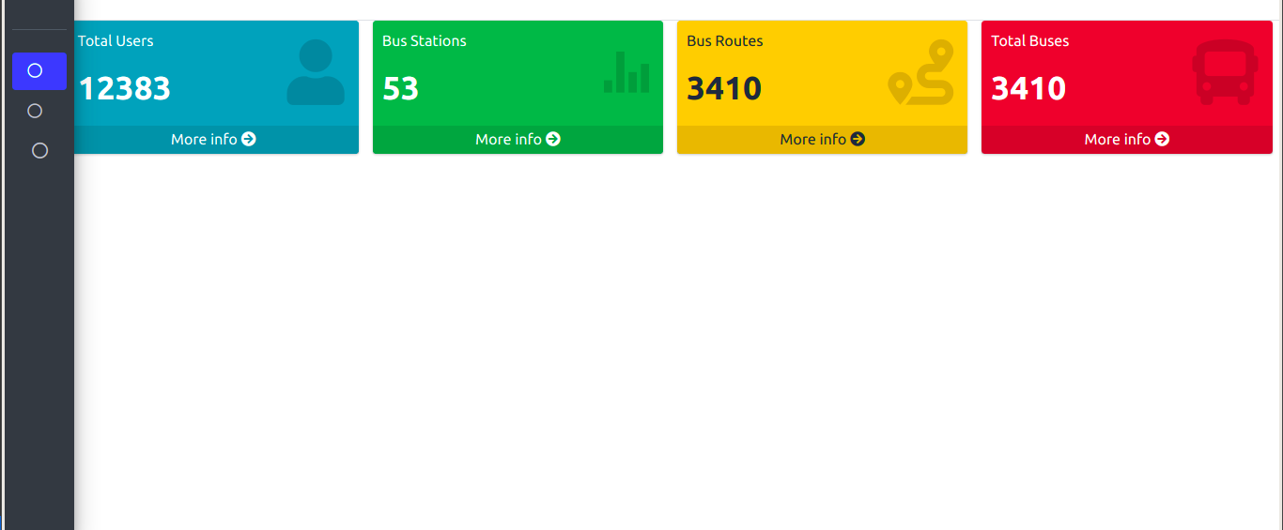
Home
Home shows app info
No: of users
No: of buses that enabled live tracking
Possible Bus routes is shown
Major stations are also listed.

Slide 20
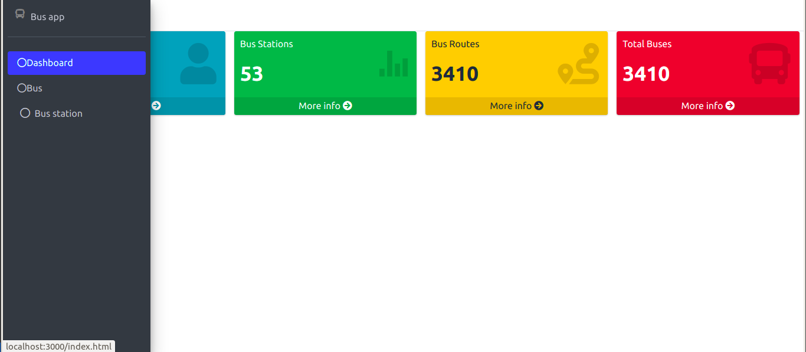
Side Bar
Sidebar navigation
Three options
Dashboard- basic app info
Bus -Details of total bus
Bus station - Available station

Slide 21
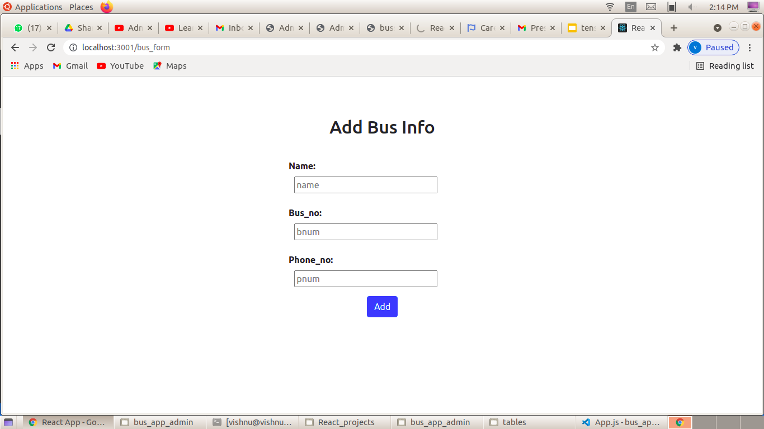
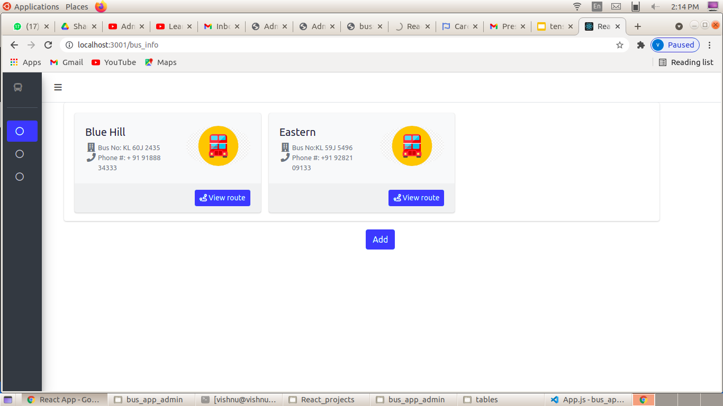
Bus
Basic bus info
Add option available

Slide 22
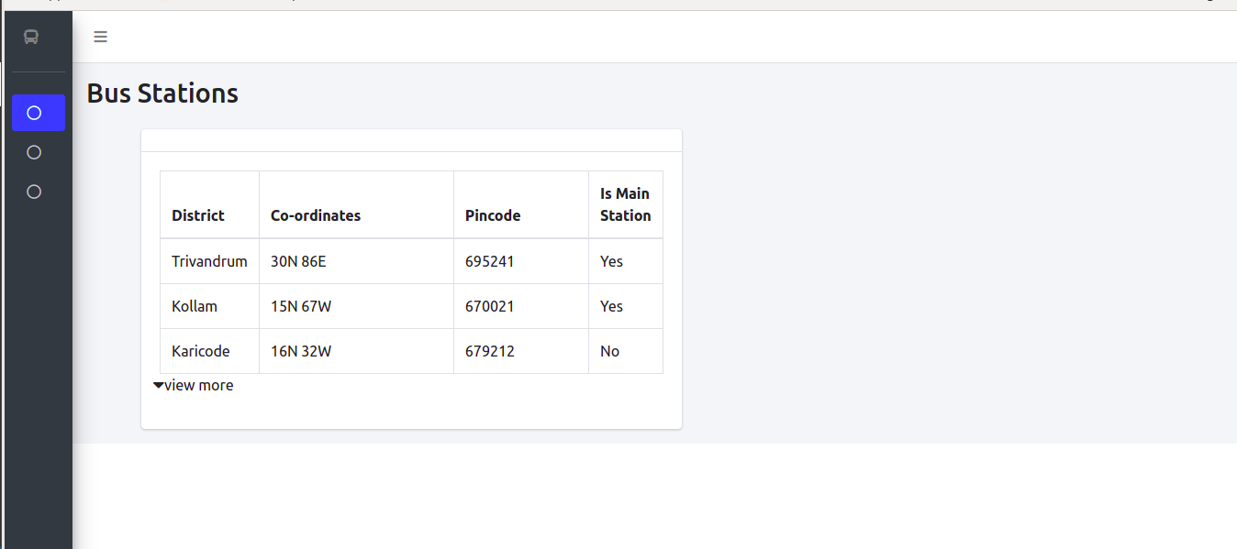
Bus Station
Station details
Name
Coordinates
Pincode
Main station or not

Slide 23
Assumptions
GPS data from bus will be available
Ticketing machine data is available

